Slide 1
Student Performance Prediction and Early Intervention
Presented By:
Akshaya KP BIO AI
Vishnumaya PK CSDA

Slide 2
Problem Statement
Predict student performance (Pass/Fail)
Analyze academic factors (study time, failures)
Analyze behavioral factors (attendance, consistency)
Identify at-risk students early
Enable timely academic intervention
PAGE 02
Notes:
The goal is to predict student performance (Pass/Fail)
using academic and behavioral factors such as study time,
absences, and past failures.
The system helps identify at-risk students early
and enables timely intervention.

Slide 3
Dataset
UCI Student Performance Dataset
Contains student academic and demographic data
Key Features:
Study time
Failures
Absences
Age
Target Variable:
Pass → G3 ≥ 10
Fail → G3 < 10
PAGE 03
Notes:
The dataset used is the UCI Student Performance dataset. It includes academic and demographic details. We focused on key features like study time, failures, absences, and age. The target is whether a student passes or fails based on the final grade.

Slide 4
Data Preprocessing
Created target variable (Pass/Fail)
Removed G3 to avoid data leakage
Encoded categorical features
Performed train-test split
Applied feature scaling
#C6A28D
#868668
#AD6237
PAGE 04
Notes:
Removed G1, G2, G3”
These are previous grades and directly influence the final grade, so including them would cause data leakage.
In preprocessing, we created the target variable, removed G1, G2, G3 to avoid data leakage, encoded categorical variables, and split the dataset into training and testing sets.

Slide 5
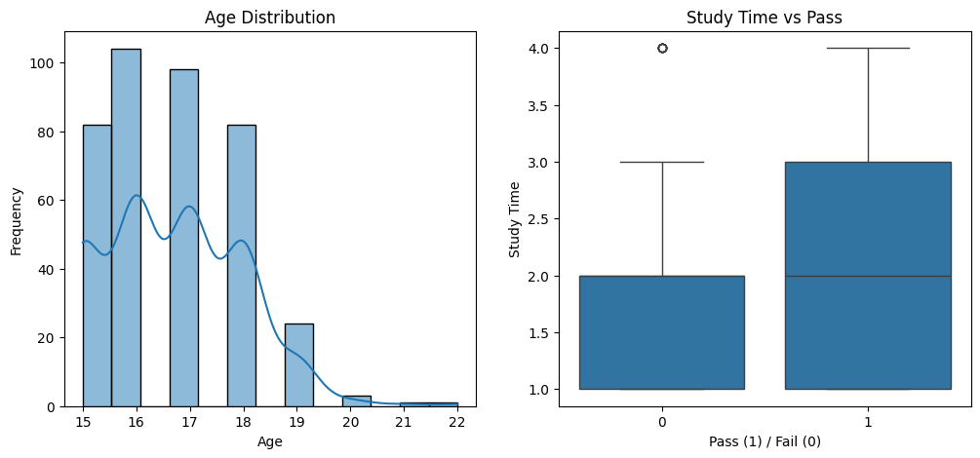
Exploratory Data Analysis
Study time positively affects performance
Higher study time increases pass rate
Failures increase risk of failing
Absences negatively impact outcomes
#868668
PAGE 05
Notes:
In EDA, we analyzed how different factors affect performance. Students with higher study time perform better, while absences and past failures negatively impact results.
This graph shows that students who study more tend to pass more, while students with lower study time have a higher chance of failing.

Slide 6
Models
Models Used:
Logistic Regression
Decision Tree
Random Forest
Best Model: Random Forest
Accuracy: 0.91
PAGE 06

Slide 7
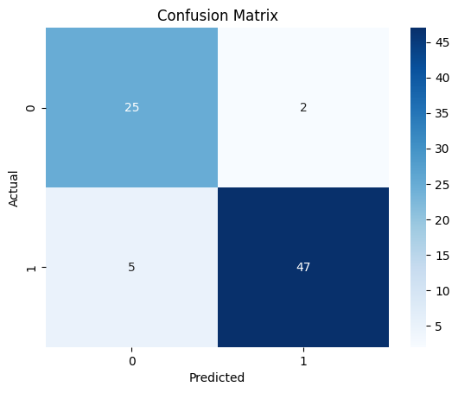
Model Evaluation
Best model : Random Forest
Accuracy: 0.91
• Model performs well for both classes
• Low number of incorrect predictions
Random Forest performed best and was selected for deployment.
PAGE 07

Slide 8
Web Application
• Developed using Streamlit
• Simple and user-friendly interface
Inputs:
• Age
• Study Time
• Failures
• Absences
• G1, G2
Output:
• Predicts PASS or FAIL
PAGE 08

Slide 9
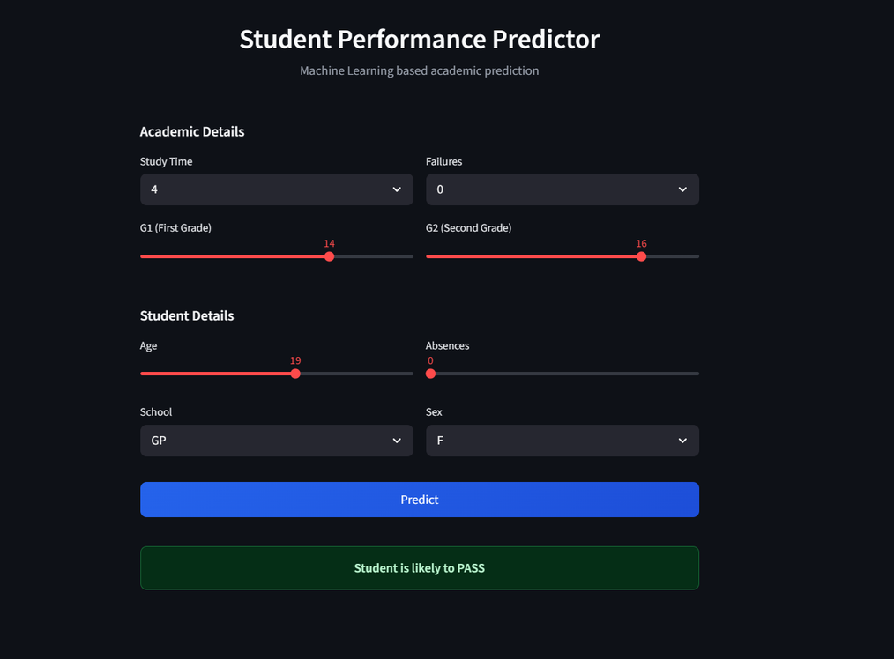
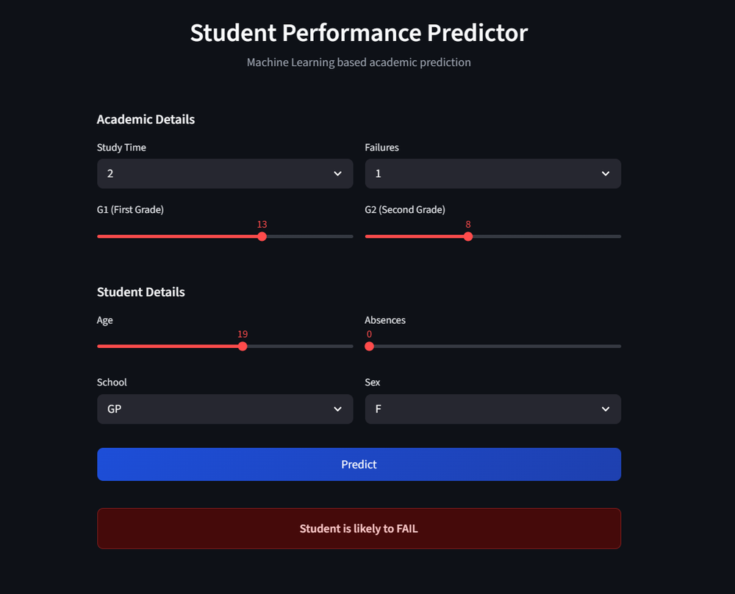
Prediction Results
Pass Prediction
Fail Prediction
PAGE 09

Slide 10
Conclusion
Model predicts student performance effectively
Random Forest selected as best model
Achieved 0.91 accuracy
Useful for early intervention
THANKS!
PAGE 10

